Slide 1
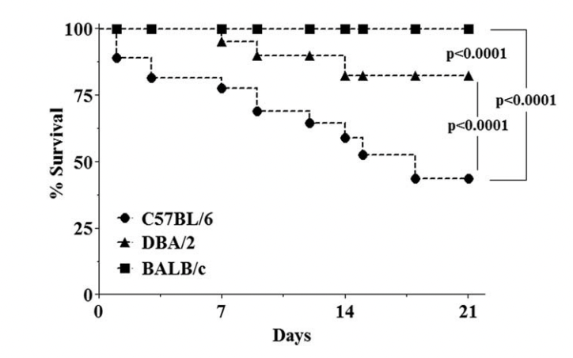
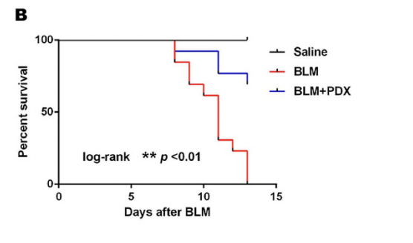
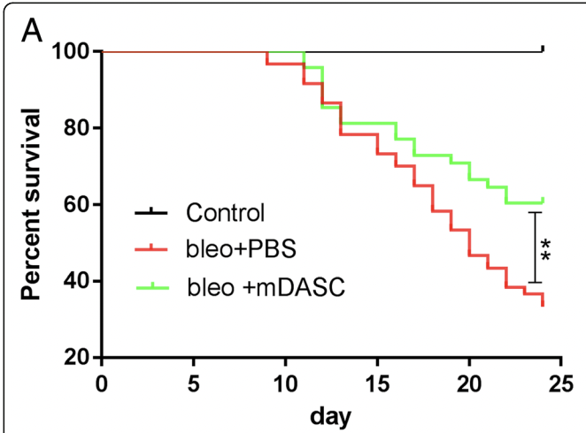
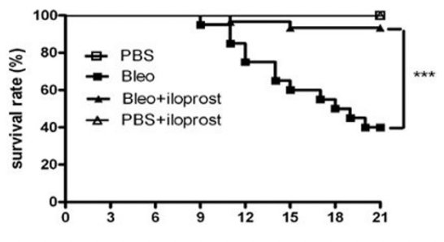
BLM-induced mortality from literature: over 50%
Toxicologic Pathology, 40: 731-741, 2012. See B6 mice curve (round dots)
Sci Rep 7, 46754 (2017) see red curve
Stem Cell Res Ther 10, 161 (2019). See red curve
Respir Res 11, 34 (2010).

